Slide 1
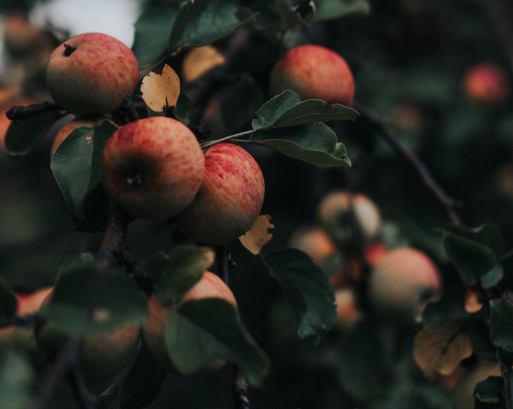
RIPEN TRACK:
FRUITS RIPENING STAGE DETECTOR
GROUP MEMBERS :-
Saloni Andey 102003730
Manmeet Singh 102003735
Brahmjot Kaur 102003736
Mitansh Trivedi 102003739
Arjun Pundir 102003742
MENTOR :-
Dr. Nitigya Sambyal

Slide 2
Table of Contents
1
7
Project in Action
Project Overview
2
Scope and Utility
8
Key Highlights
3
Objectives
9
Project Analysis and Design
4
Literature Survey
10
Results
5
Architecture
11
Individual Roles
6
Tools and Technology
12
Learnings

Slide 3
Project Overview
In large-scale produce farming, human judgment causes inefficiencies.
Imprecise ripeness determination leads to economic losses and raises environmental concerns due to increased wastage.
Ripen Track aims to transform ripeness detection in large-scale production.
Promote efficient distribution of fruits.
By eliminating human judgment inefficiencies, the project aims to enhance overall efficiency in fruit production.

Slide 4
Scope and Utility
Scope
Mass Production: Minimize wastage in large-scale processing.
Farmer Prediction: Aid farmers in optimal harvest timing decisions.
Storage Efficiency: Provide crucial ripening data for better storage and consumption
Sustainability Focus: Reduce food wastage for an eco-friendly approach.
Utility
Supply Chain Efficiency: Enhance agricultural and retail supply chain management
Quality Assurance: Ensure fresher, higher-quality produce for consumers.
User Empowerment: Classify fruits into four stages, guiding appropriate actions.

Slide 5
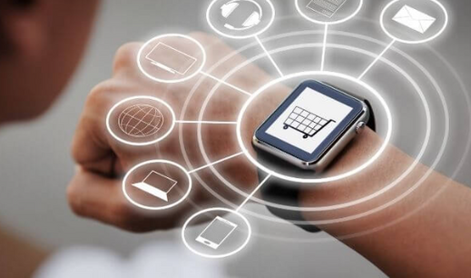


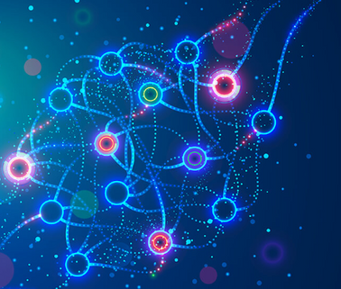
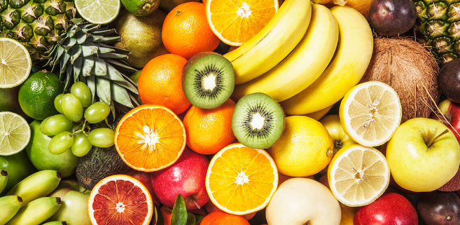
Objectives
To study the various models proposed in the literature for detection of fruit ripening.
To develop a Machine Learning based model for multistage classification of fruit ripening.
1
3
Employ ESP32 Wroom32 and a visible light sensor to capture fruit color information for the preparation of a dataset.
To develop a web application using Flask to predict the ripeness stage of fruits.
4
2

Slide 6
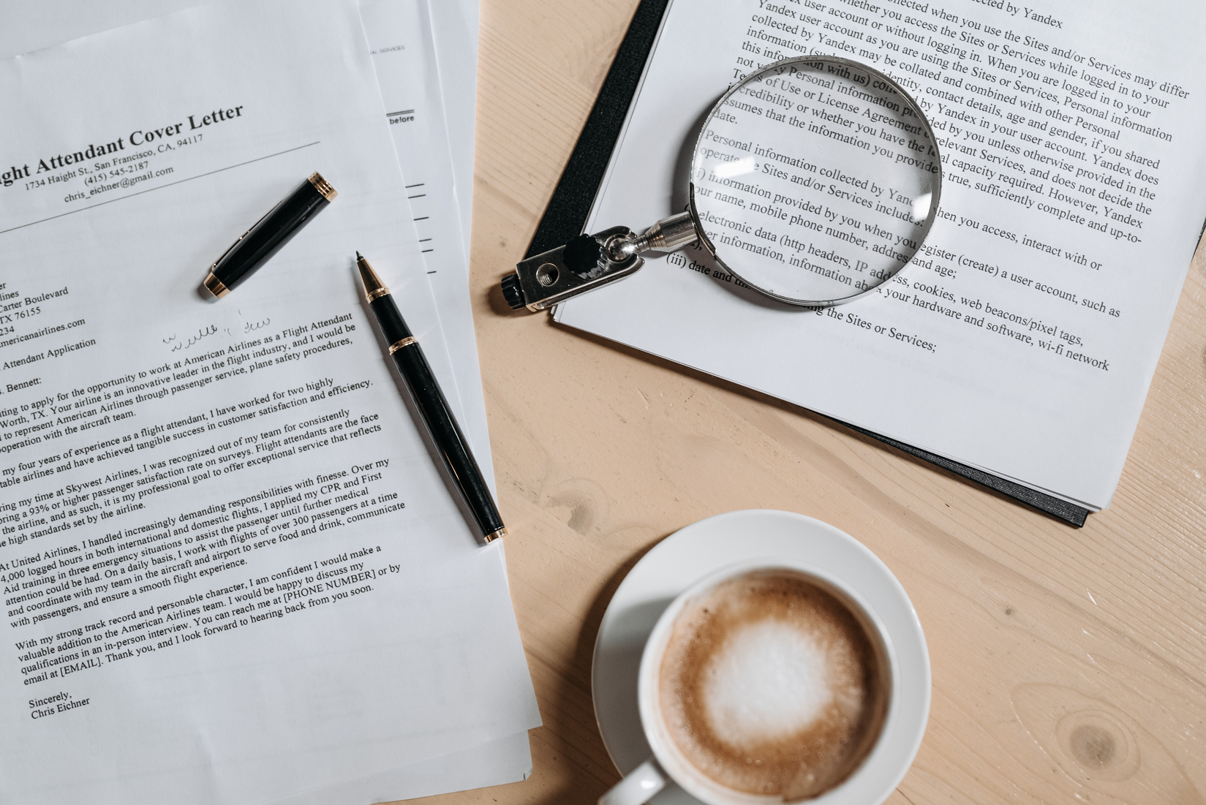

Literature Survey
Existing Solutions | Findings | Tools/ Methods Used
[1] Ripeness Detector for Vegetables and Fruits -2022 2nd International Conference on Intelligent Technologies (CONIT) Karnataka, India | Using an artificial neural network, this research describes a system that uses the RGB color space. | Spectral Analysis, Deep Learning, Artificial Neural Networks (ANN)
[2] Determination of the level of ripeness and freshness of fruits by electronic sensors. A review | Digital electronic platform, equipped with gas sensors , estimating a relationship between the gases (O2,CO2) and the level of ripeness. | Digital electronic platform,gas sensors and wireless network
[3] Monitoring Ripeness in Fruits and Vegetables Using the Raspberry Pi ,A. Jayalakshmi; L Poojitha Reddy; M Srikar Preetham | Insights of how Electronic sensors and other IOT devices can be used to collate data for ripeness detection in fruits. | Pic Microcontroller development board, conveyor, motors, and Pi camera, raspberry pi , Image processing
[4] Real-time hyperspectral imaging for the infield estimation of strawberry ripeness with deep learning | This proposed system is used to detect ripeness of fruits,using the hyperspectral imaging (HSI) system in field and laboratory conditions in this study | Spectral Analysis, AlexNet CNN (Convolutional Neural Network), Deep learning and Hyperspectral Imaging (HSI) system.
[5] Determination of Ripeness and Grading of Tomato using Image Analysis on Raspberry Pi | An edge detection algorithm is used to estimate the shape and size of tomato and color detecting algorithm is used for the ripeness determination | Raspberry pi, conveyor belt, motors, Pi camera and Image processing.

Slide 7
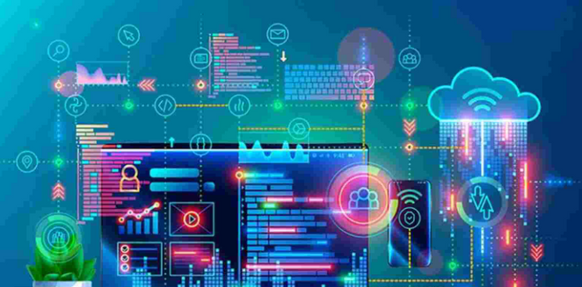
Literature Survey
Problems Identified
Non existence of Hardware oriented prototype to Collate Fruit ripening data on the basis of Spectral colour of fruits
.
Requirement of a Web Service based on reliable Prediction model to predict ripeness of fruits through the spectral data features..
1
2

Slide 8
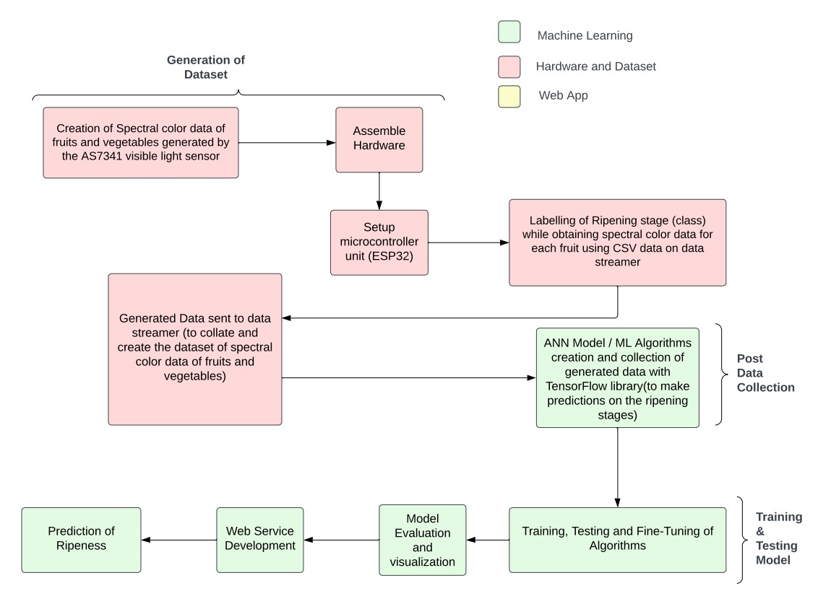
Methodology

Slide 9
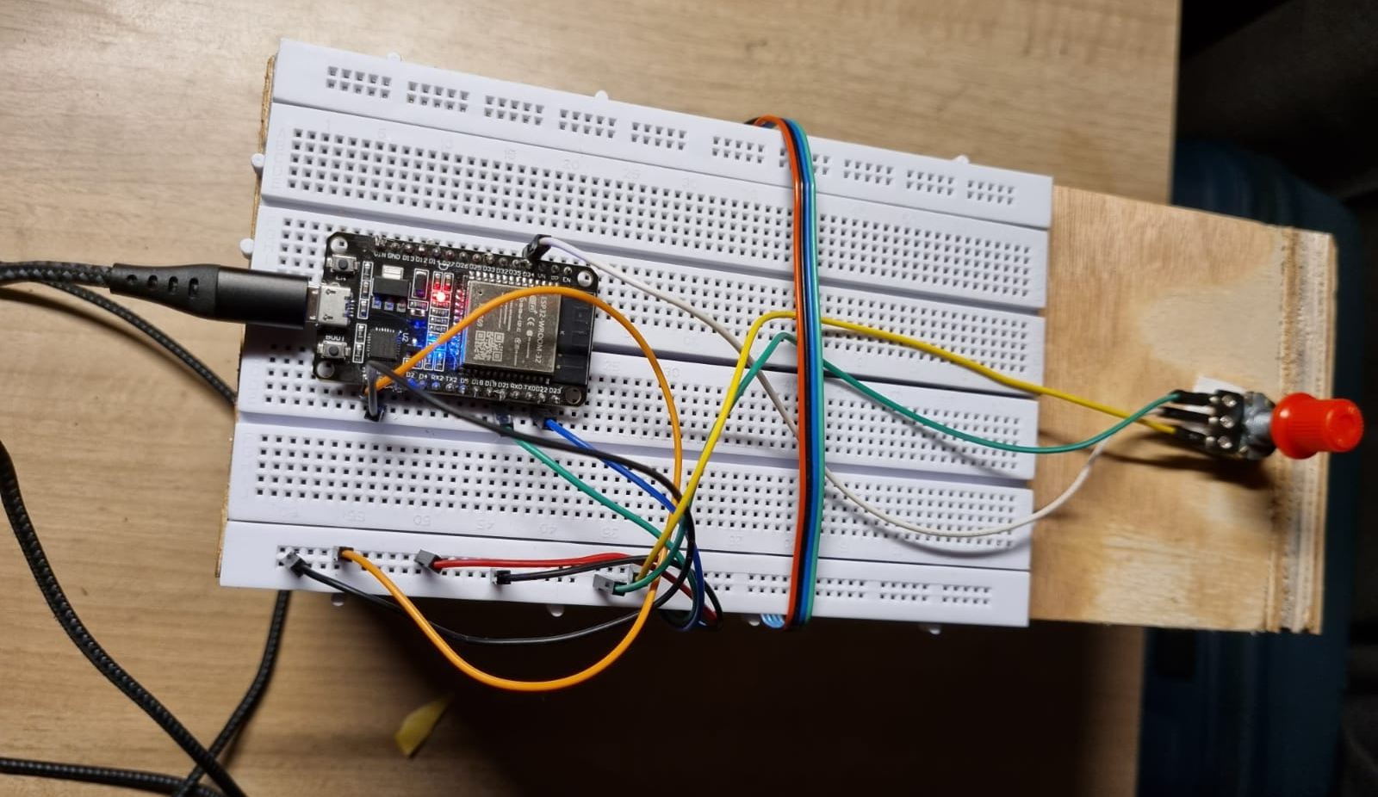
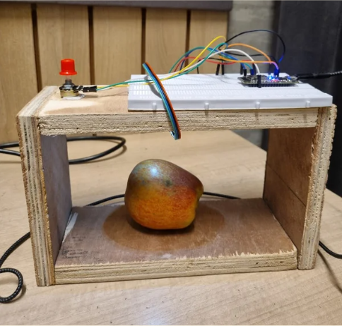
Project Presentation in Action

Slide 10
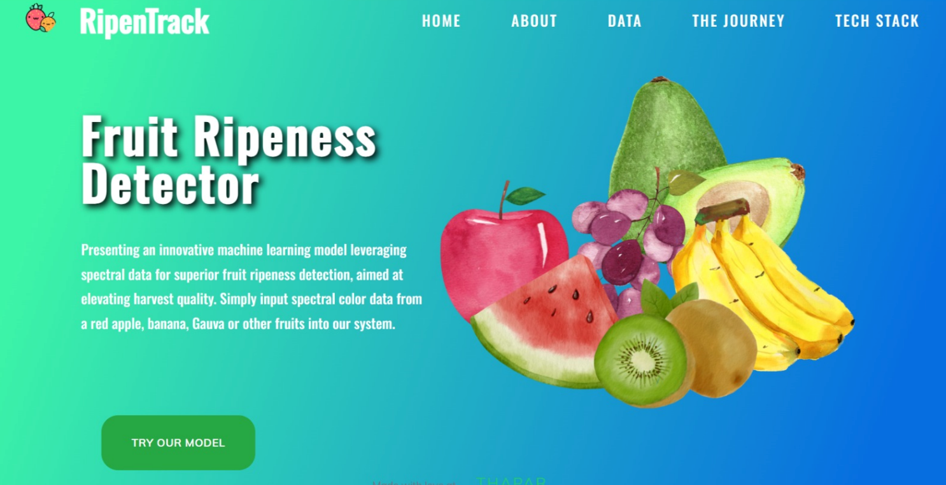
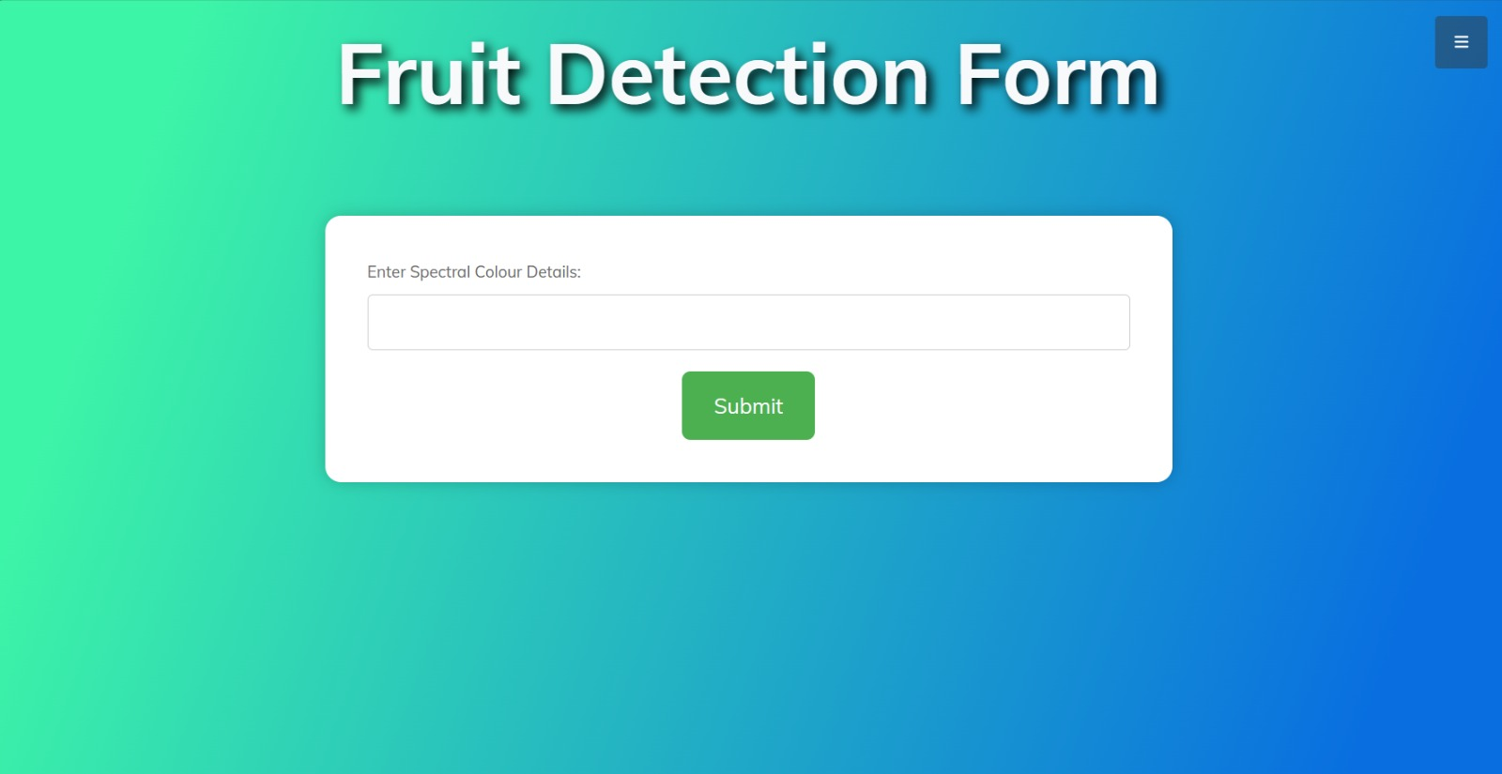
Screenshots Of Website

Slide 11
Tools and Technology Used
Web Development Frameworks (Flask)
IDEs (Jupyter Notebook, Visual Studio Code)
Google Colaboratory
Tensorflow
Artificial Neural Network
ESP32 Wroom32
AS7341 Color Sensor

Slide 12
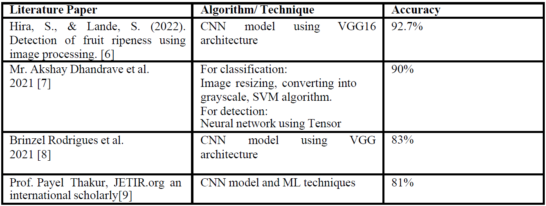
Key Highlights
Affordable Innovation: We prioritize affordability, delivering a cost-effective ripeness detection solution for large-scale production.
Spectral Precision: Ditching traditional images, we leverage spectral data for superior accuracy, capturing nuanced details often missed in visual assessments.
Deeper Insights: Our system delves into intrinsic produce characteristics, setting a new standard for precision and reliability in ripeness detection.

Slide 13
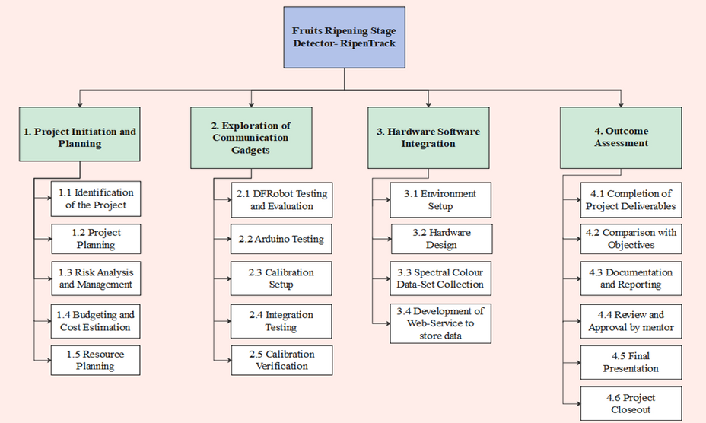
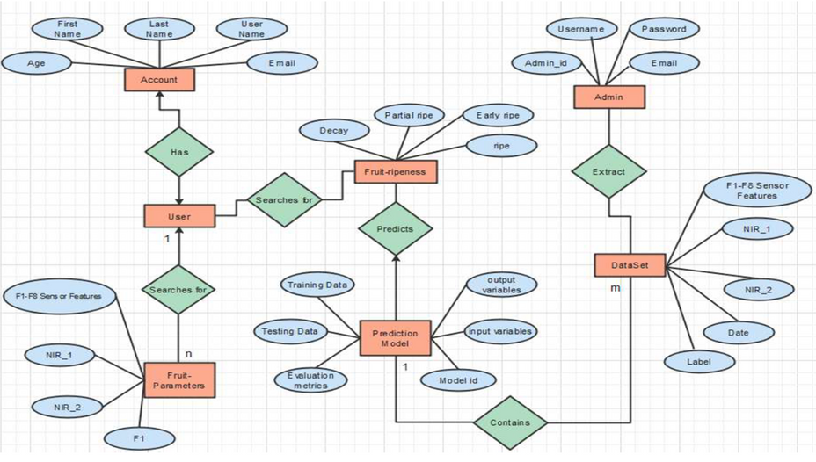
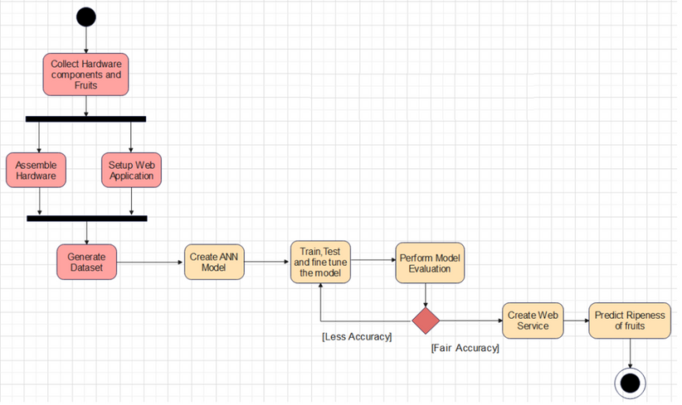
Project Analysis and Design
Work Breakdown Structure
1
Entity Relationship Diagram
3
Activity Diagram
2

Slide 14

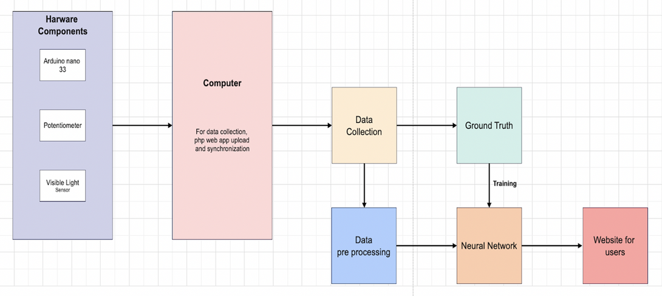
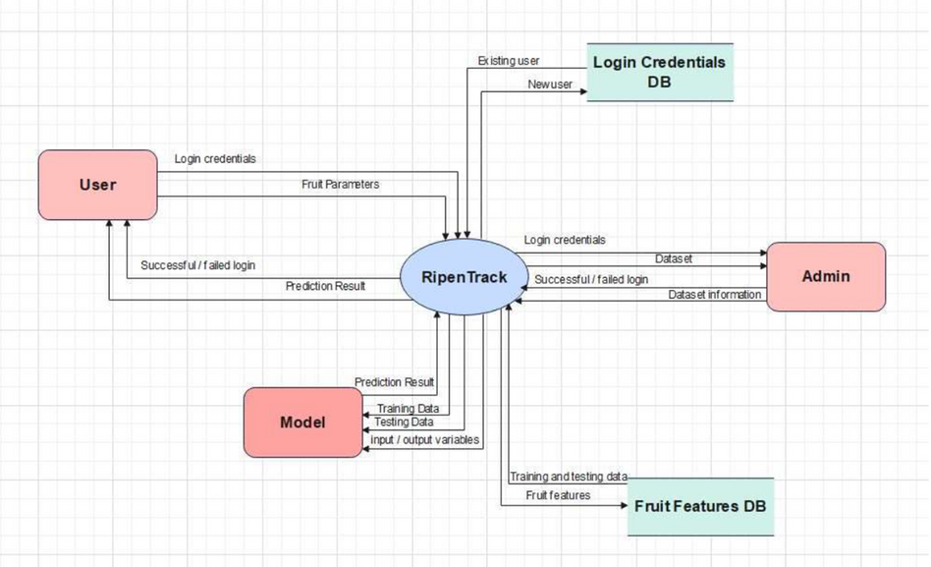
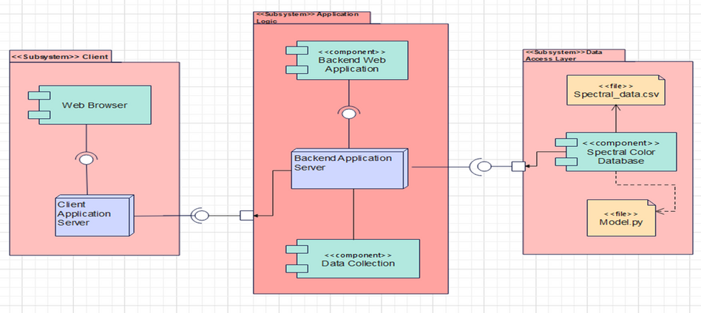
Detailed Design
2
1
Block Diagram
3
Data Flow Design
Component Diagram

Slide 15
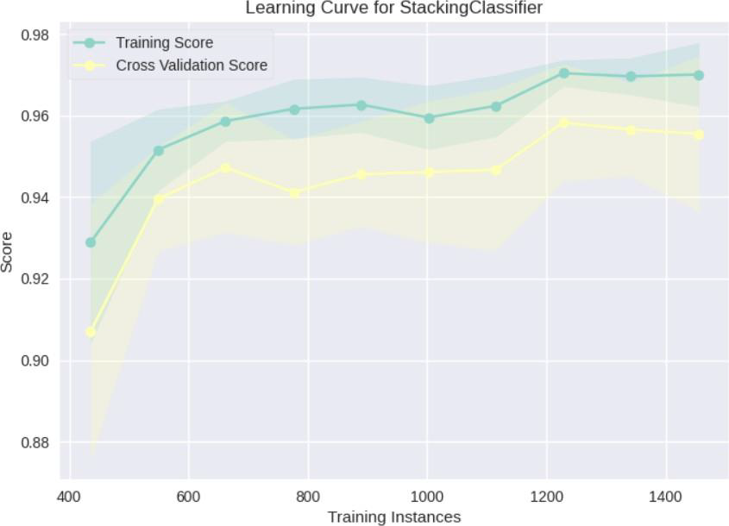
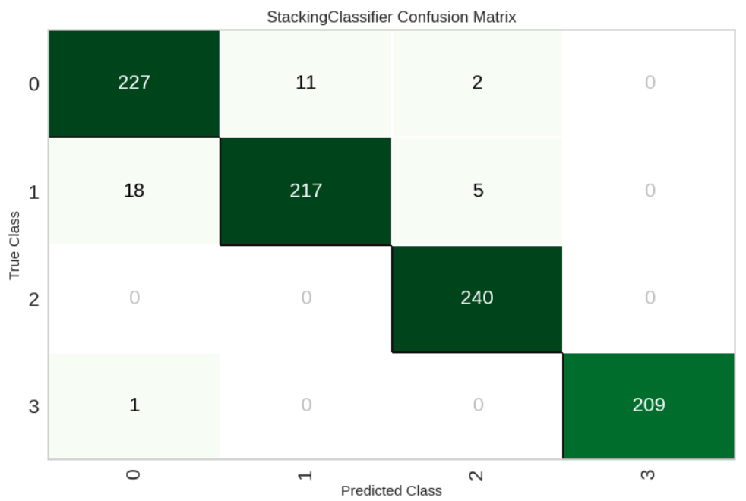
Results
Accuracies
1
Model | Accuracy | Precision
ANN | 80%
SVM | 85.4% | 82%
Naïve Bayes | 89.94% | 90.08%
KNN | 93.12% | 93.39%
Ensemble of (SVM, KNN, Naïve Bayes) | 94.04% | 95.4%
2
3
Learning Curve For Stacking Classifier
Confusion Matrix

Slide 16
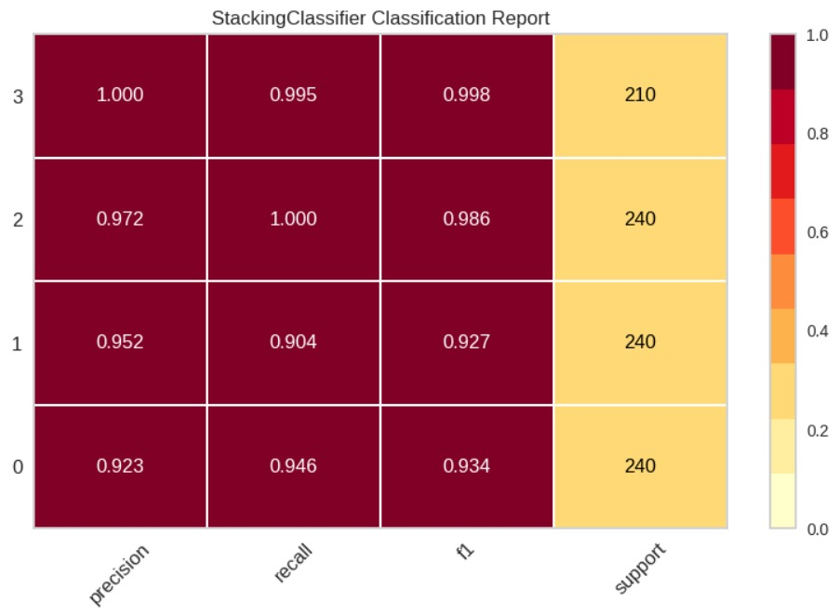
Results
Classification Report

Slide 17


Individual Roles
Arjun Pundir and Manmeet Singh:
Configured ESP32 Wroom32 for seamless hardware integration.
Ensured compatibility with light sensor and potentiometer for data streamer.
Organized collated data in the database for structured neural network training.
1
Brahmjot Kaur and Arjun Pundir:
Collected dataset using hardware setup, developed initial ANN model with 80% accuracy, refined with SVM, KNN, and Naive Bayes.
achieving 94% accuracy through ensemble learning.
2
Saloni Andey and Mitansh Trivedi:
Created Flask app integrated with ML model for spectral color dataset prediction.
Developed user-friendly web interface with dynamic forms and robust validation checks.
3

Slide 18
Professional and Technical Learnings
Proficient in integrating hardware, software, and machine learning components
Hands-on experience in implementing IoT for real-time data processing.
Applied literature insights to optimize ML model for enhanced performance.
Applied Flask framework for creating a user-friendly project interface.
Used Jupyter, VS Code, and Colaboratory for collaborative coding and model development.
Enhanced presentation and communication skills through live project demonstration.

Slide 19
Thank You

